Slide 1


PREPARING FOR SUMMER HEAT
AND WILDFIRES
Discussing the current heat and wildfire landscape and predictions across the state while exploring affordable and easy tools to beat that heat and filter your air as needed!

Slide 2
Agenda
1 | WELCOME
2 | OPENING REFLECTION
3 | SUMMER OF EFFICIENCY
4 | SUMMER 2025 HEAT
5 | SUMMER 2025 WILDFIRES
6 | CLOSING REFLECTION
7 | COMING UP!
8 | THANK YOU

Slide 3
Land Acknowledgement
We are located within the unceded territories of Northwest Native nations. Our office is on the traditional land of the first people of Seattle, the Duwamish People past, present, and future.

Slide 4
Summer of Efficiency
Summer 2025 is Earth Ministry/Washington Interfaith Power & Light’s Season of Efficiency. We seek to find and encourage ways to integrate community support into resilience project plans and implementations including accessible and affordable community options outside of solar.

Slide 5
Summer Heat and Wildfires
Preparing for Summer Heat and Wildfires, is about discussing the current heat and wildfire landscape and predictions across the state while exploring affordable and easy tools to beat that heat and filter your air as needed!

Slide 6

Summer 2025 Heat
We are no stranger to the fact that Washington summers are getting longer, hotter and potentially more dangerous as the years go on. According to climate scientists, the number of very hot days and extreme heat events will increase across the state, though by how much varies depending on location and future greenhouse gas emissions.
K & P

Slide 7
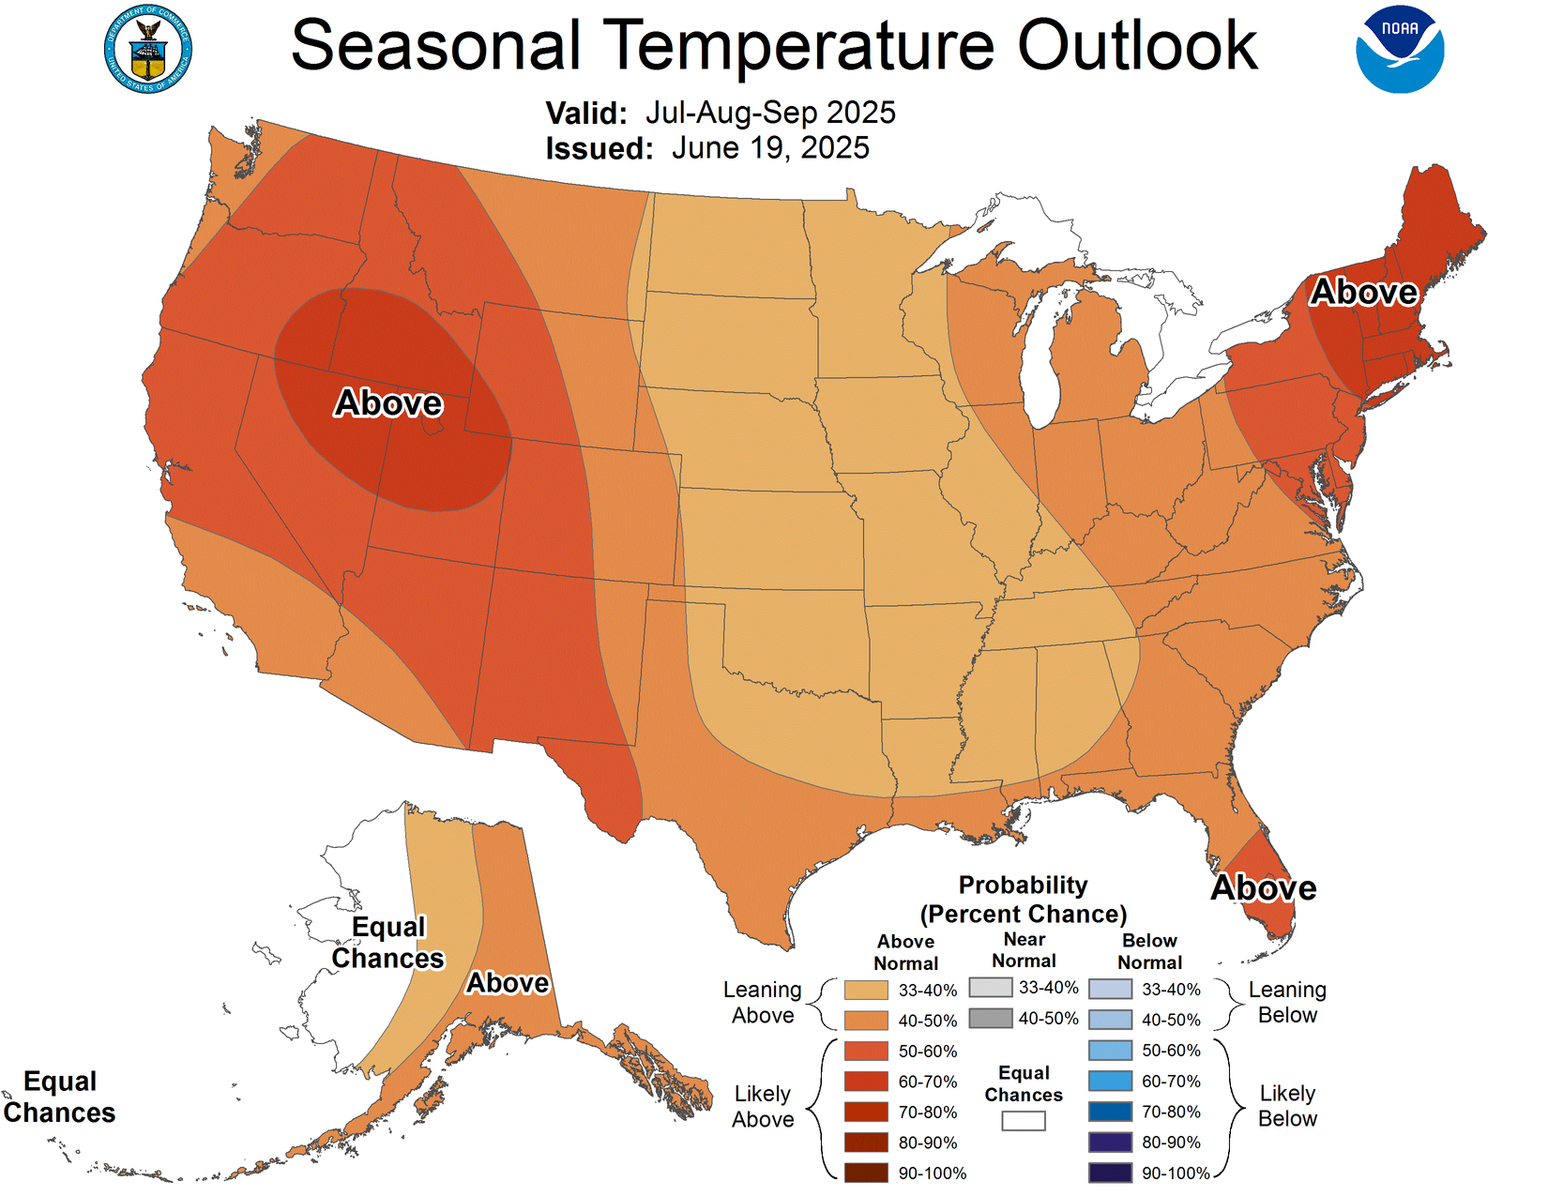
Summer 2025 Heat - Forecast
K & P

Slide 8
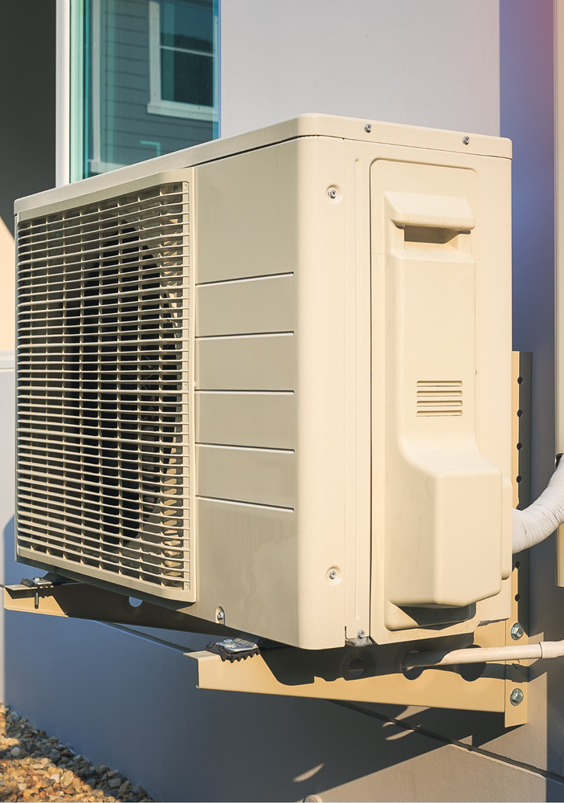
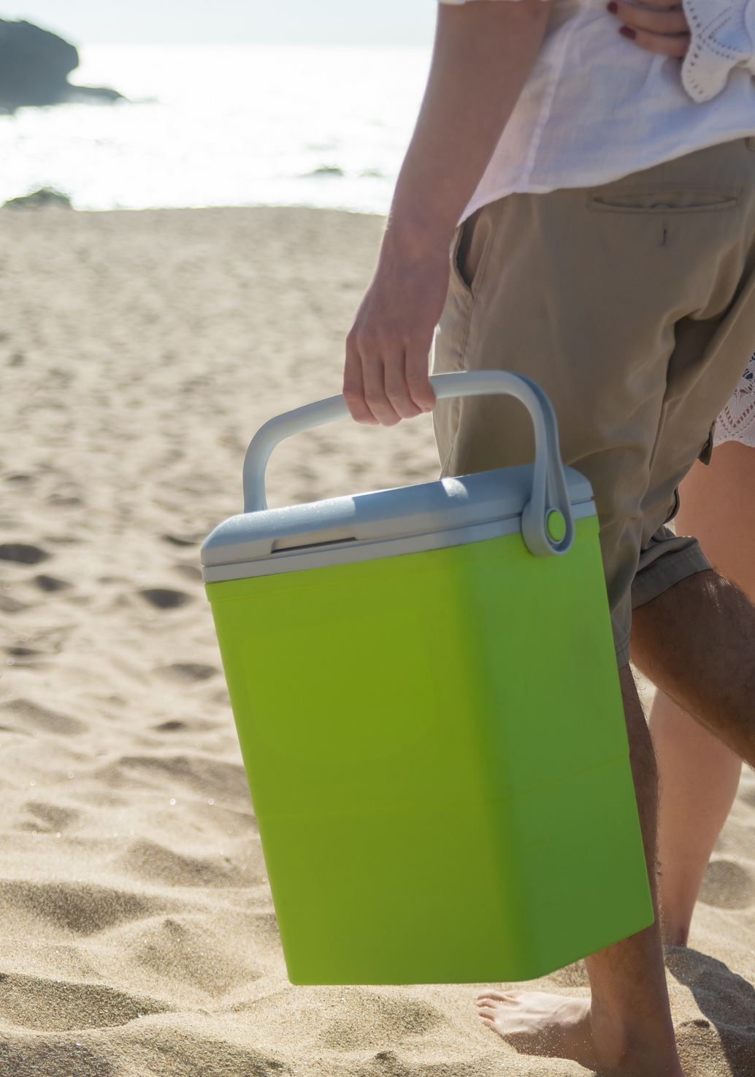
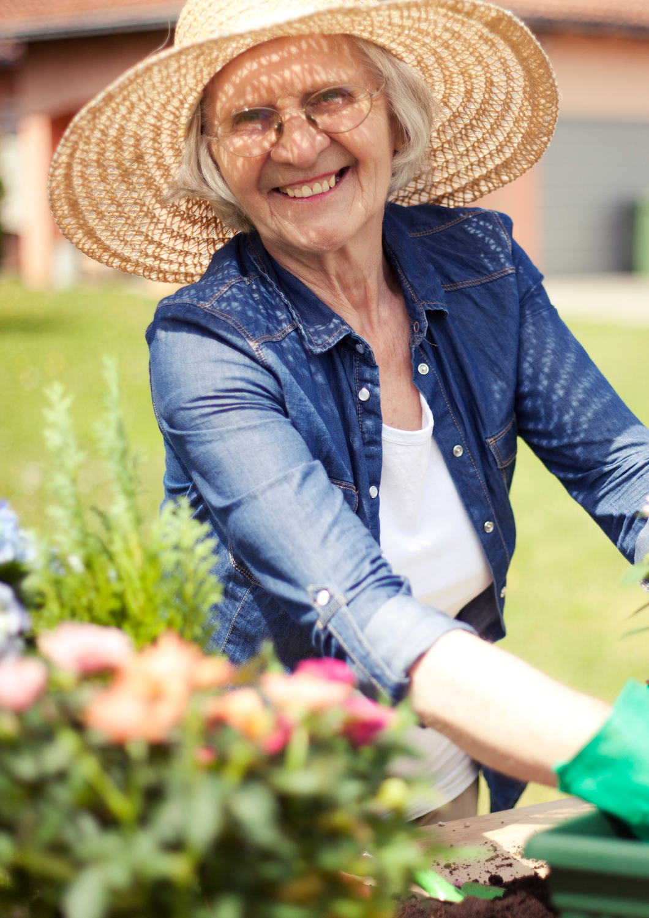
Summer 2025 Heat - Community
K & P

Slide 9
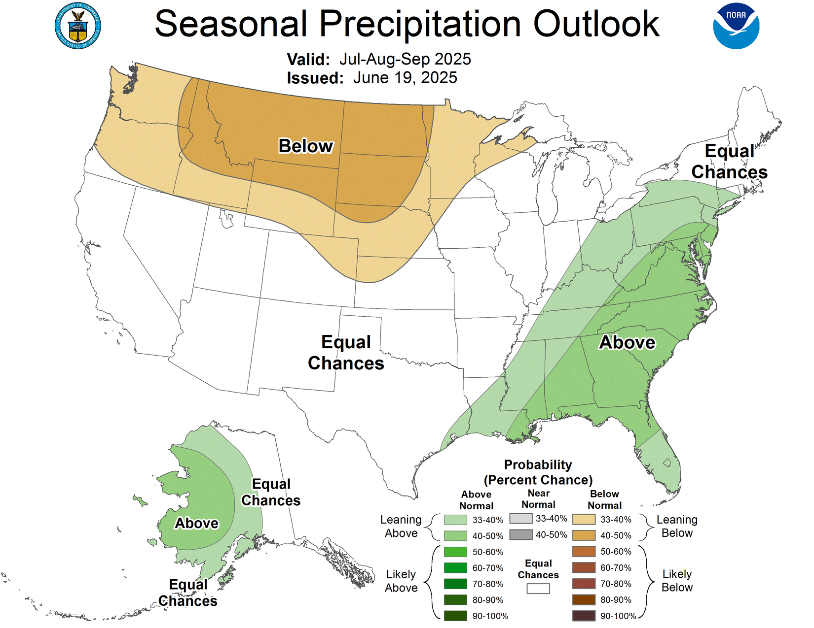
Summer 2025 Heat - Droughts
K & P

Slide 10
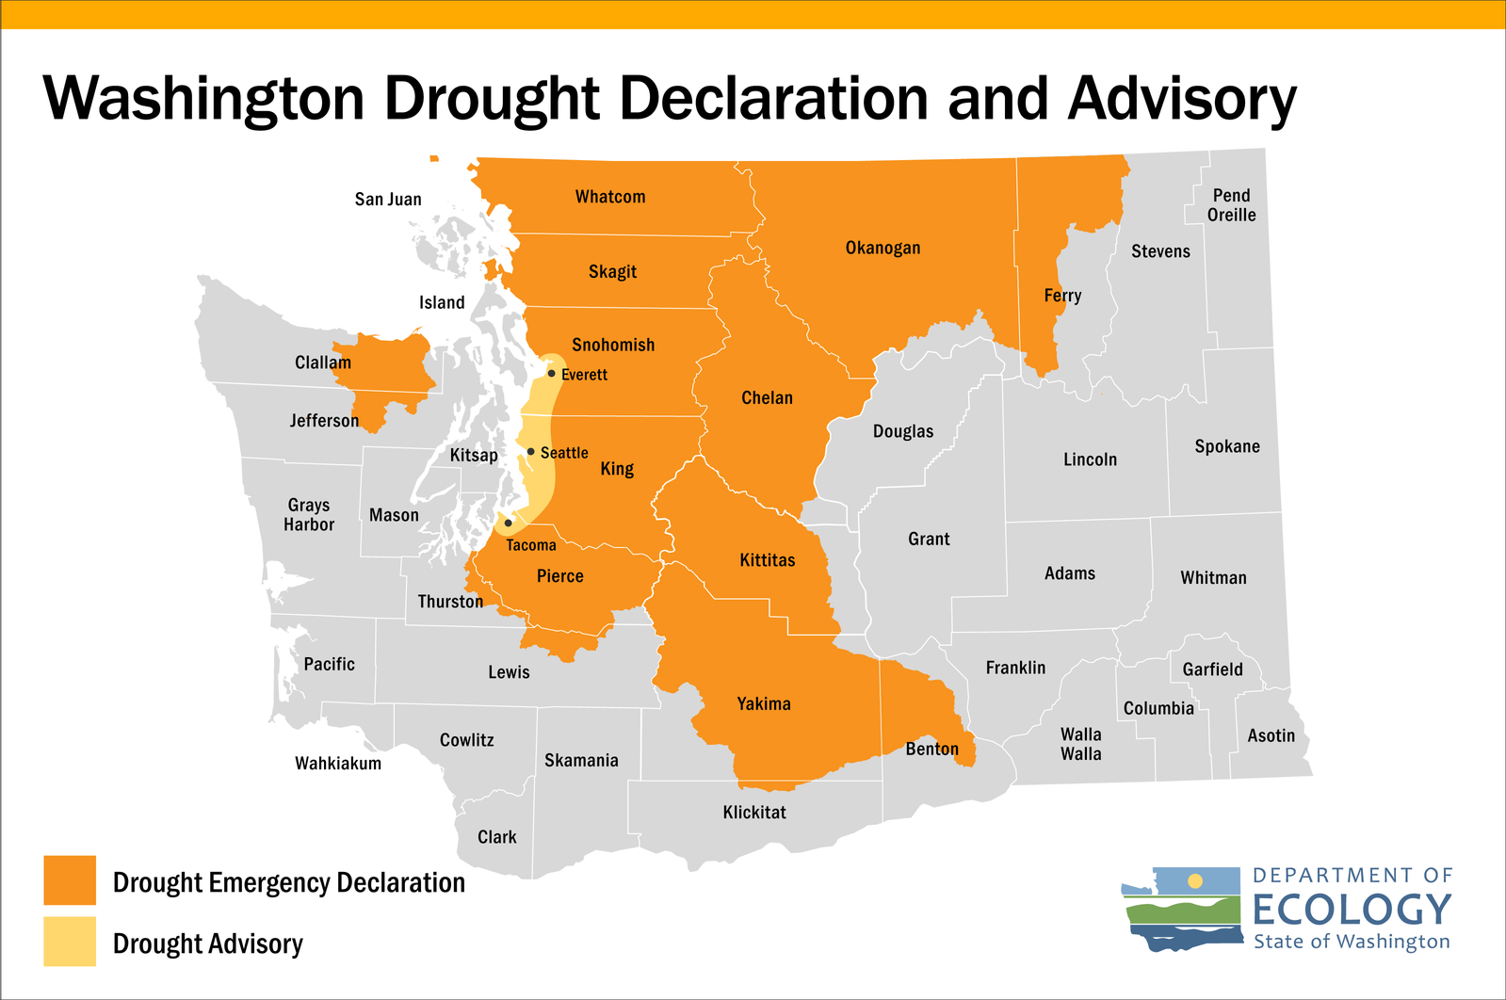
Summer 2025 Heat - Droughts
K & P

Slide 11
Summer 2025 Wildfires
As sunny days and warmer weather return to Washington state, so too do the risks of wildfire season.
Parts of Washington state are already under a drought proclamation. Current forecasts indicate a higher than-normal risk of wildfires for much of the state starting this month and continuing through September.

Slide 12
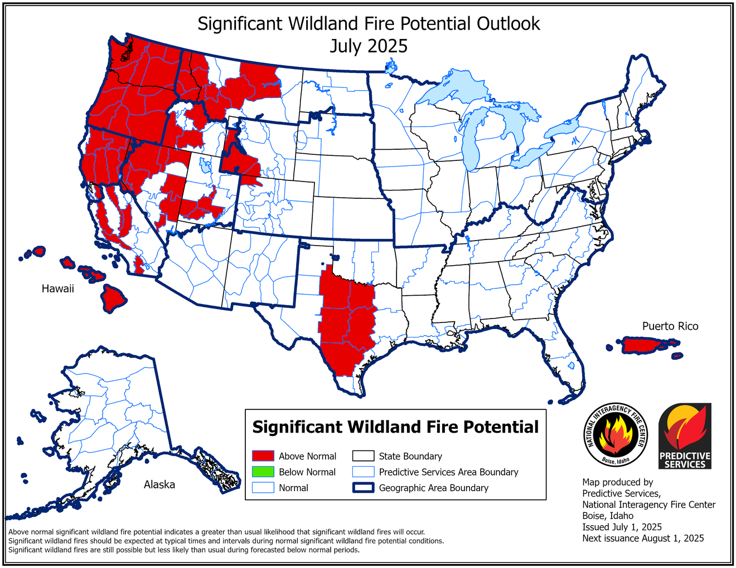
Summer 2025 Wildfires - Forecast

Slide 13
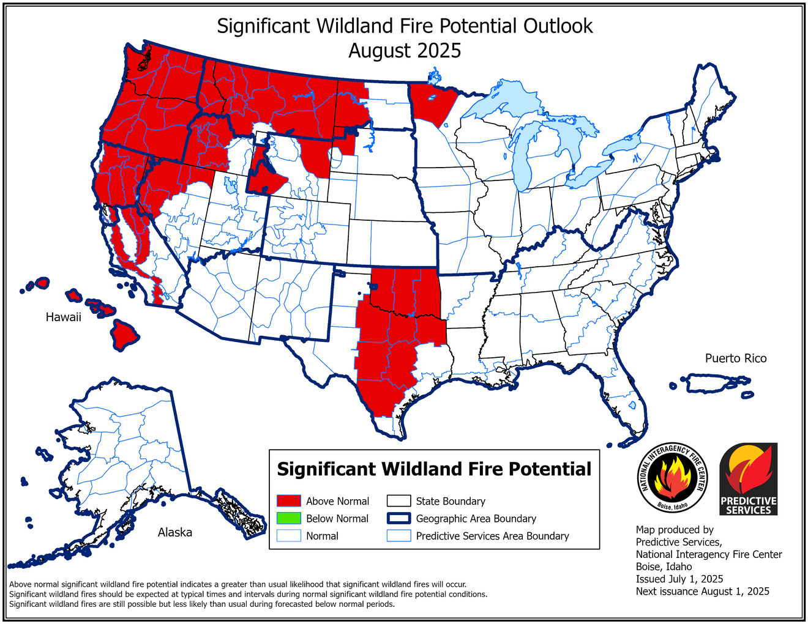
Summer 2025 Wildfires - Forecast

Slide 14
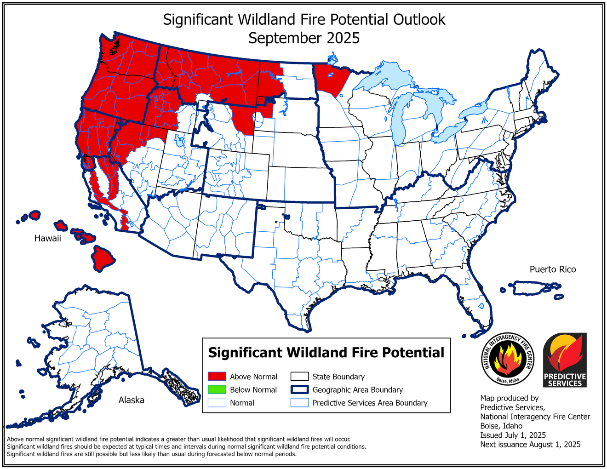
Summer 2025 Wildfires - Forecast

Slide 15
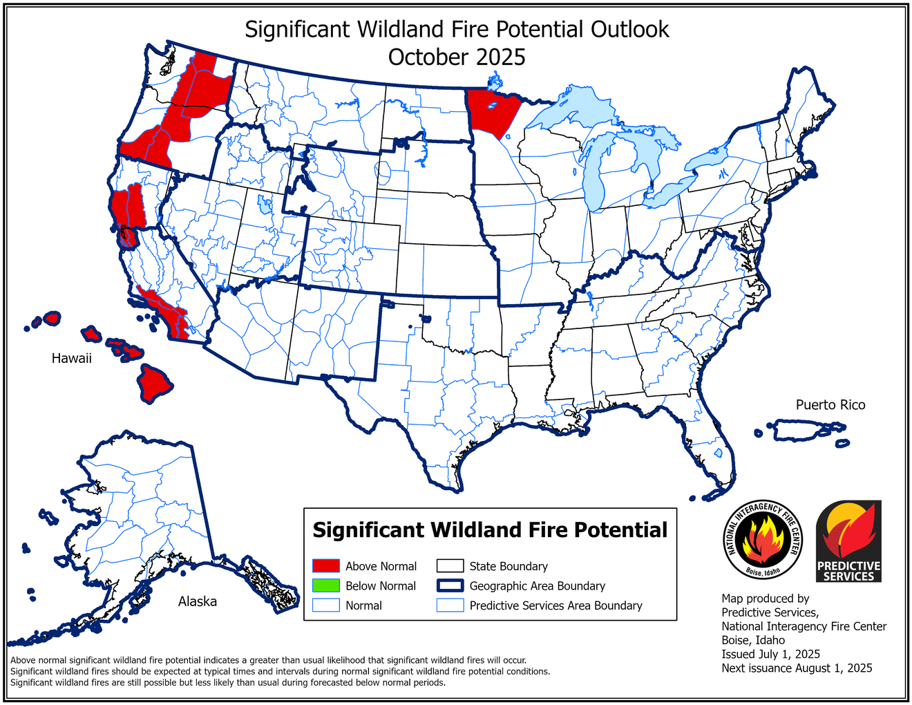
Summer 2025 Wildfires - Forecast

Slide 16
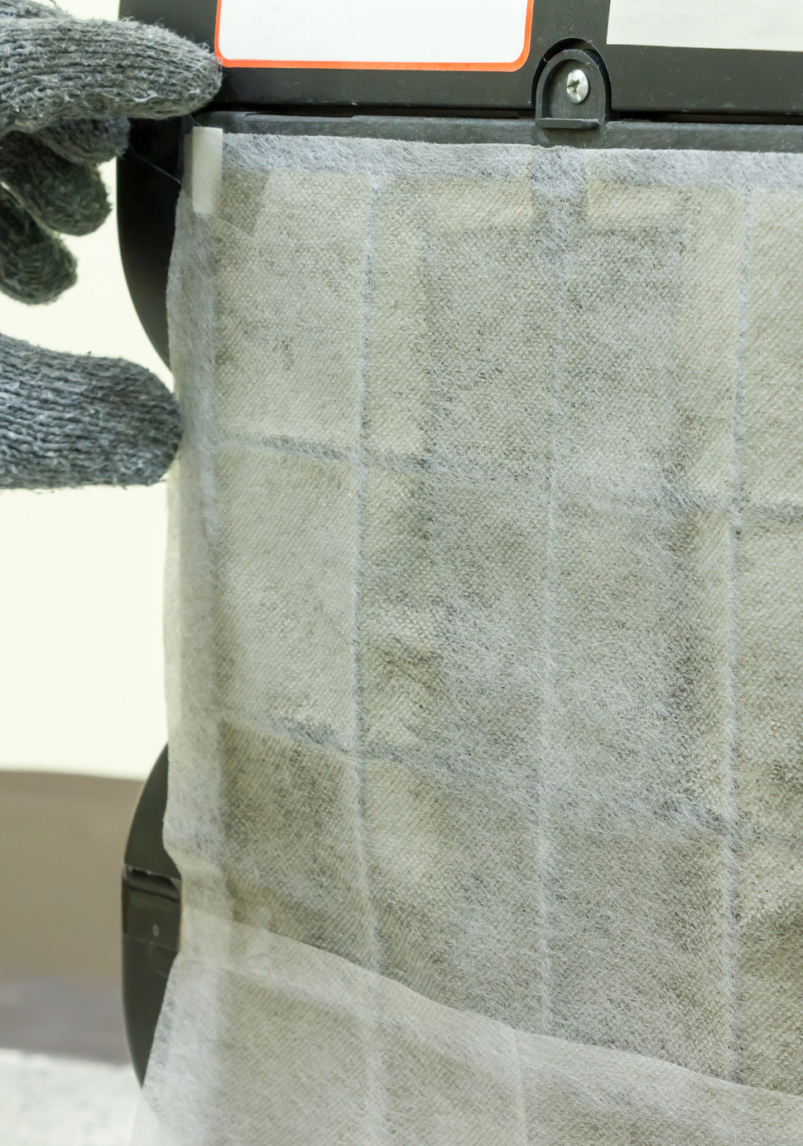
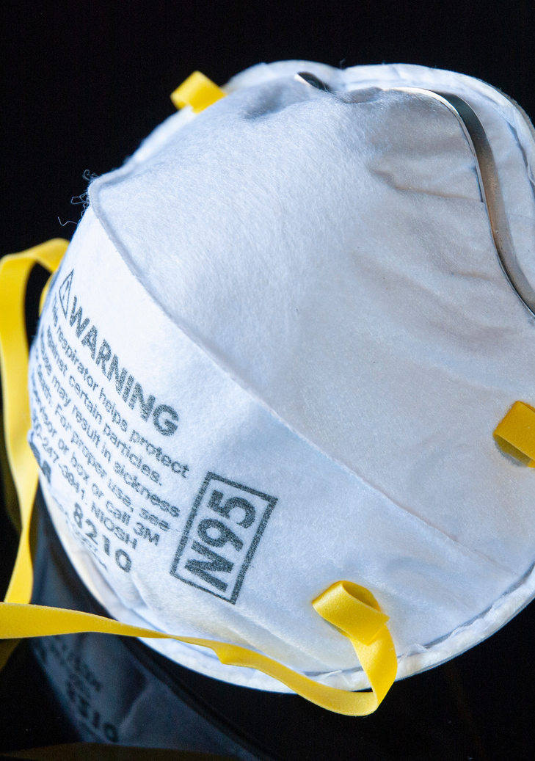
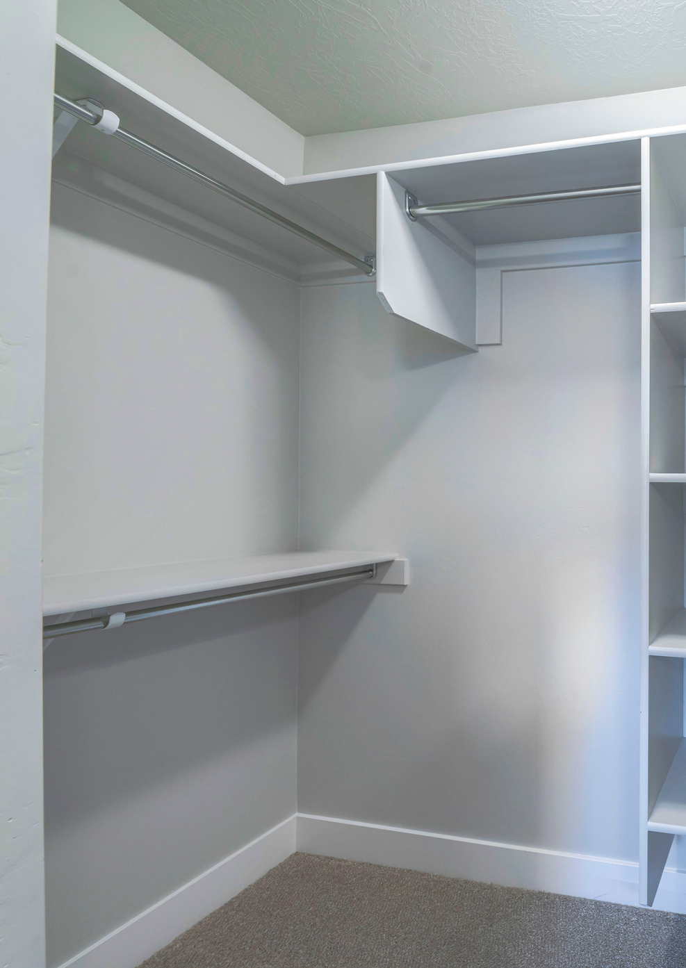
Summer 2025 Wildfires
K & P

Slide 17
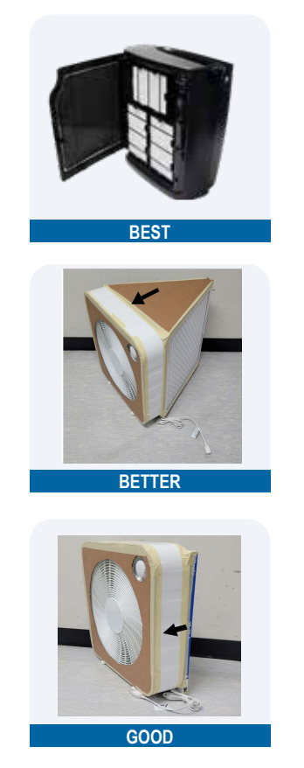
Summer 2025 Wildfires - DIY Filter
Making your own box fan filter (also called a DIY box fan filter) can be a less costly option to filter air and improve indoor air quality in a single room or designated space.

Slide 18
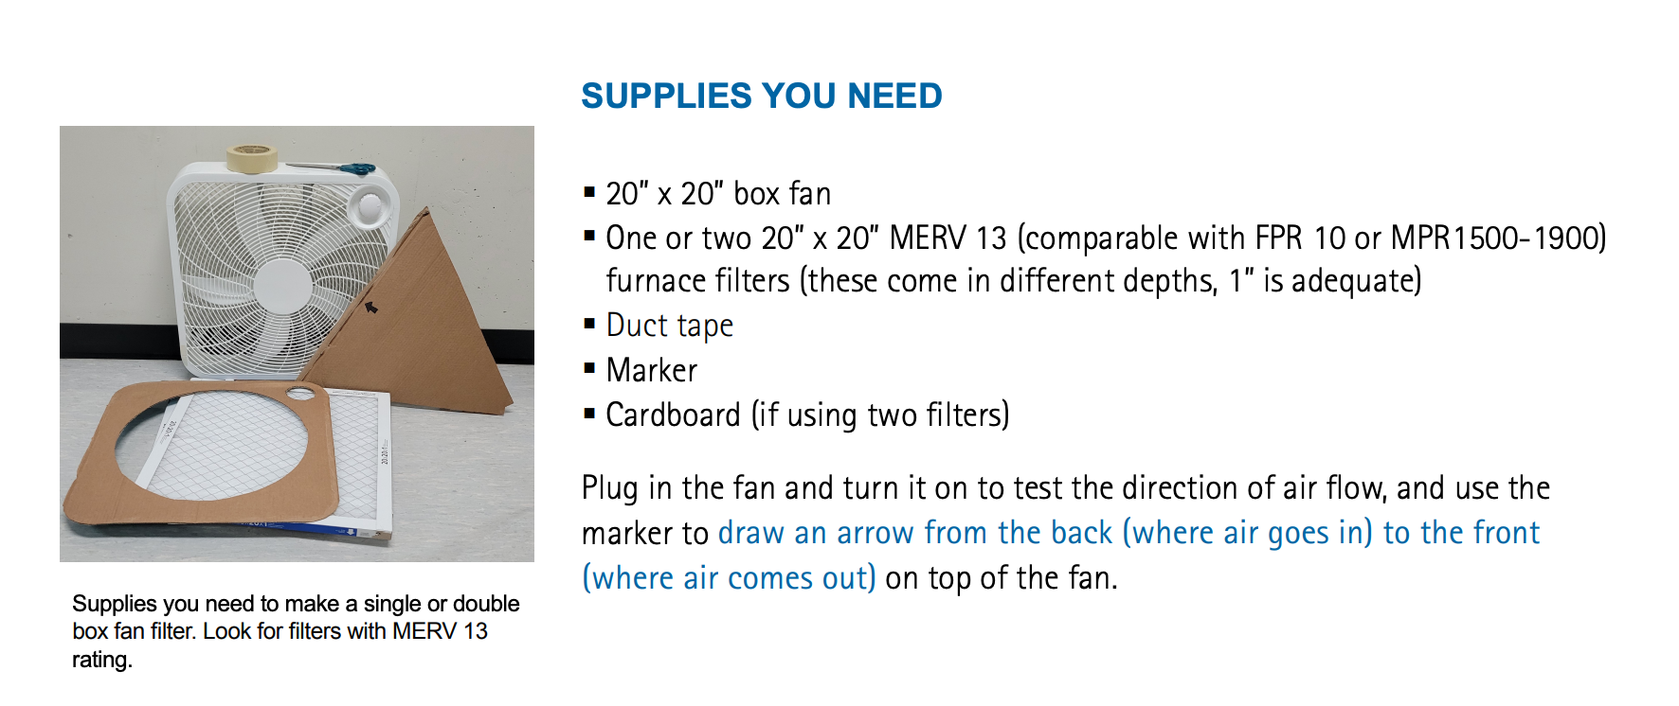
Summer 2025 Wildfires - DIY Filter

Slide 19
Coming Up - Urban Exploration
August 12
7:00 - 8:00 PM
Zoom
In what ways can those of us in cities be more mindful in nature and take advantage of the beauty of our state?
Join us on August 12 to discuss outside activities and the critters we get to meet!

Slide 20
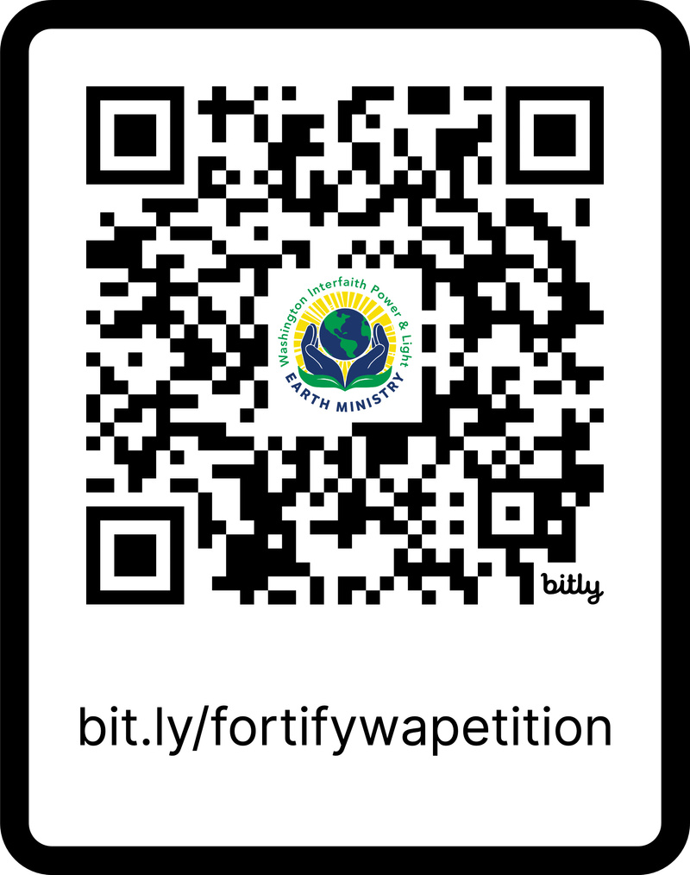
Coming Up - Fortify Washington
Our newest advocacy program is called Fortify Washington! Think fortifying ourselves in a nourishing sense as well as a protective sense. Fortifying ourselves from the cruelty and chaos that is pouring down from above, while working proactively for a now that is environmentally-just, racially-just, equitable, and sustainable.

Slide 21
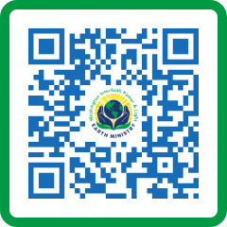
Thank You, Donors
Thank
You!

